Slide 1
Retrieval of Relevant Answers
to StackOverflow Queries by
Ranking the Answers
Akhil Kumar Baipaneni • Gayathri Chandrasekaran • Madhuri Yadav

Slide 2
Agenda
Introduction
Aim
Dataset Overview
Data Preprocessing
Data flow & experimental setup
Results
Challenges
Future Scope

Slide 3

Stackoverflow is a question and answer site for professional and enthusiast programmers.
It is the most used Q&A forum by software developers
It features wide range of topics in computer engineering
Holds answers for many challenges faced by developers
Has collection of 18 million questions
50 million people visit Stack Overflow per month
Issues with existing search engine:
Even if questions exist in SO they are not retrieved by the search engine.
Ex. node - how to run node app.js?
SO allows different set of answers for each duplicate question.
Ex. How to convert a string to a list in Python?

Slide 4

Aim
To improve, StackOverflow search using semantic similarity between questions & answers and retrieve the most relevant answers using a ranking methodology.

Slide 5
Dataset - Python Questions from Stack Overflow
Source - https://www.kaggle.com/stackoverflow/pythonquestions
Range - August 2, 2008, to October 19, 2016.
Questions - 607,282 rows & 6 cols
Columns - ID, Title, Body, Creation date, Score, and Owner id
Answers - 987,122 rows & 6 cols
Columns - ID, Body, Creation date, Score, Parent id and Owner id
The ParentId column links back to the Questions table.

Slide 6
Data Preprocessing
Subset of data - WH questions - 22722
Text preprocessing
Lower case
Tokenization
Converting accented characters
Removed stop words
HTML tags - decomposed apart from <p> & <pre>
Removed codes,images, url tags
Vectorizing the text using tf-idf, word2vec, BERT
No stemming and Lemmatization was performed to preserve domain-specific words.

Slide 7
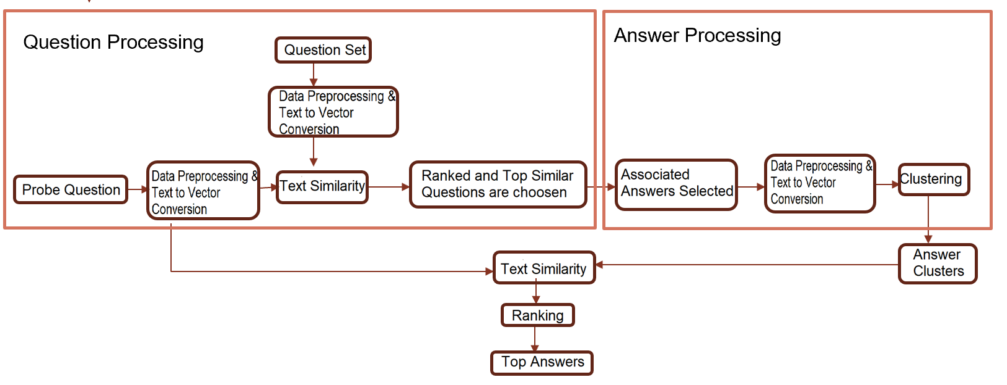
Experimental Setup

Slide 8
Text Similarity & Clustering Models used
Question Processing:
Text to Vector Conversion: word2vec, Bert embedding
Similarity: Cosine Similarity
Ranking: Similarity Score - word2vec + Bert
Answer Processing:
Text to Vector Conversion: TF-IDF, word2vec, Bert embedding
Clustering: Hierarchical Clustering
Similarity: Cosine Similarity
Question & Answer Similarity:
Similarity: Cosine Similarity - word2vec & Bert embedding
Ranking: Score * Similarity Score

Slide 9

Results
Example:

Slide 10
Challenges & Future Goals
Challenges:
Differs from Traditional Q&A systems
Domain-specific terms to be preserved
Majority of answers contains codes, images, links as a predominant part
Future Goals:
Extend the research for other Q&A pairs apart from WH-questions.
Build models that represent the entire Stack Overflow corpus having various programming domain-specific results.
Build an interactive Q&A search engine and related API for wider use.

Slide 11
Thank You

